Slide 1
Six Sigma Evaluation of Ritz Theater
By: Owen Telis, Isaiah Sarria, William Viherek

Slide 2
Introduction
The Ritz Theater management in Winter Haven aim to find the baseline metrics of the venue’s performance during the year of 2017 to help initiate a series of improvements to preserve the historic theater.
As a Six Sigma team, we will be analyzing revenue data and other variables to see how they are affecting these numbers. Then, we can determine what’s relevant to the business.

Slide 3
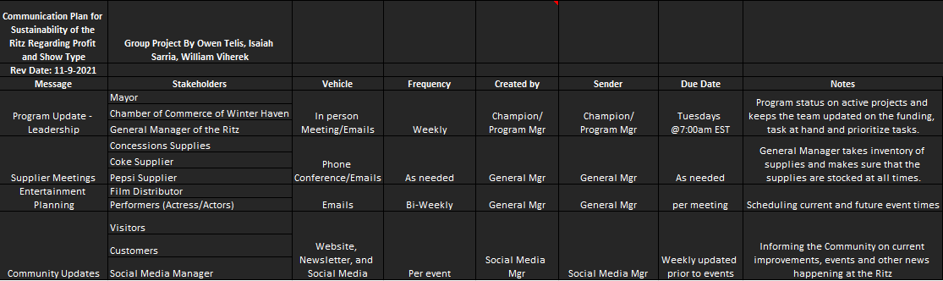
Communication Plan

Slide 4
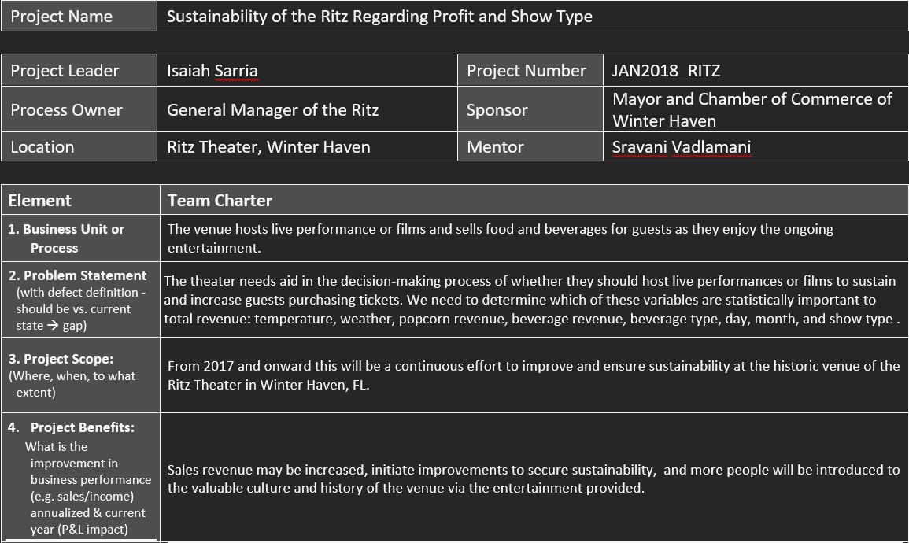
Project Charter

Slide 5
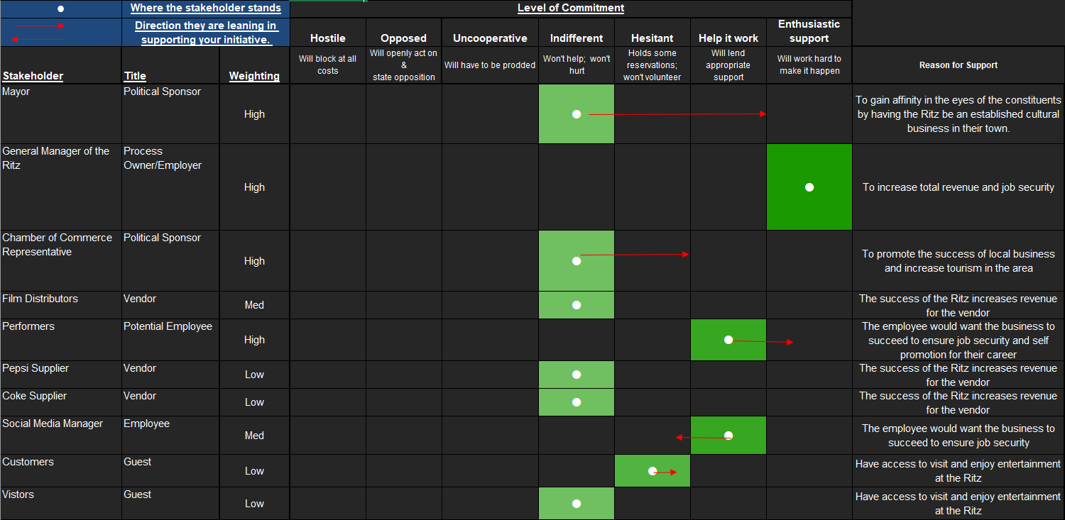
Stakeholder Assessment

Slide 6
Brief Vocabulary Explanation
A hypothesis test (T-Test) evaluates two mutually exclusive statements about a population to determine which statement is best supported by the sample data.
If the p-value is less than 0.05, we reject the null hypothesis that there's no difference between the means then we conclude that a significant difference does exist. If the p-value is larger than 0.05, we cannot conclude that a significant difference exists.

Slide 7
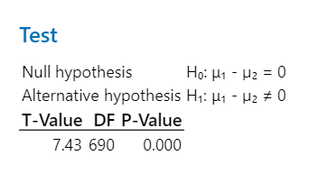
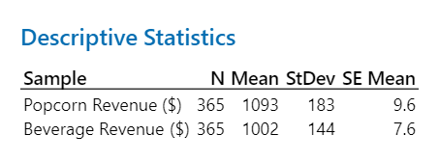
Significance of beverage and popcorn sales
Using a 2 sample T-Test, we found there is a difference in revenue between popcorn and beverages due to the P-Value being less than .05.
On average, popcorn brings in more revenue, but without knowing the costs of either item, we cannot confidently suggest changes.

Slide 8
Key Variables to predict Total Revenue
Revenue of Tickets
Show Type
Beverage Sales
Popcorn Sales

Slide 9
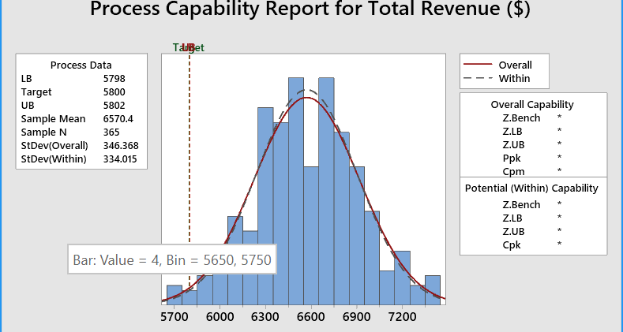
Revenue Performance and Targets (Six Sigma Levels)

Slide 10
Six Sigma Level of the Process
To find out the six sigma level we used the Z Score formula. This allows us to find out the amount of defects when it dropped below $5800.
The Z score formula is the Sample mean minus the target value divided by the standard deviation: (6570.4-5800)/(364.4) = 2.22 six sigma.

Slide 11
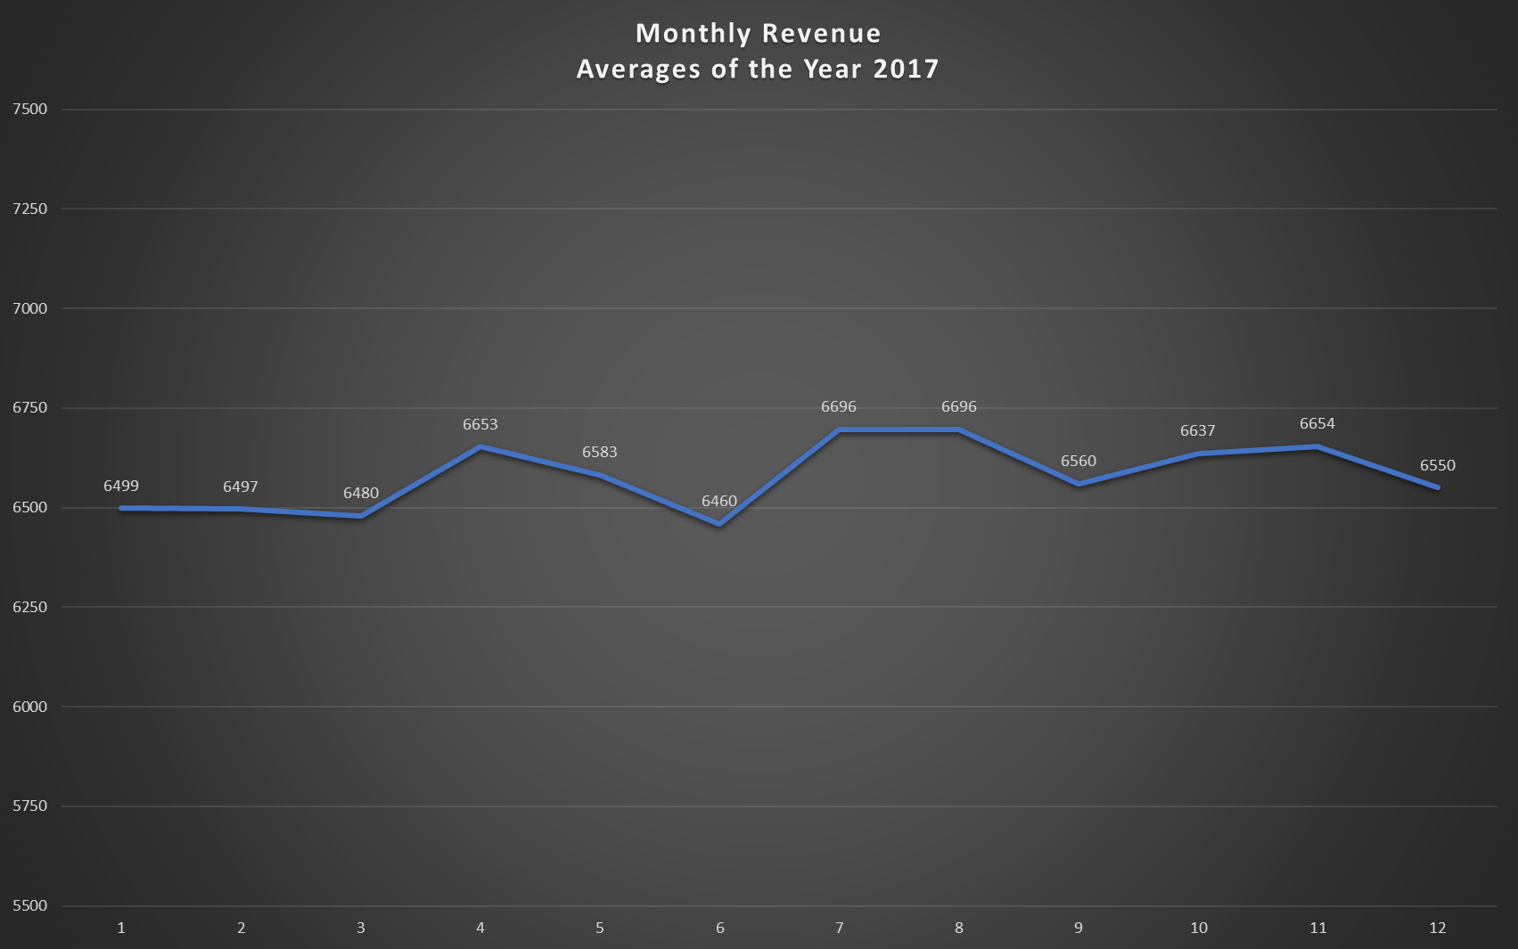
We’re interested in any process changes in June and July. After some initial revenue increase, June gradually became the worst performing and then the two next months were our best in July and August.

Slide 12
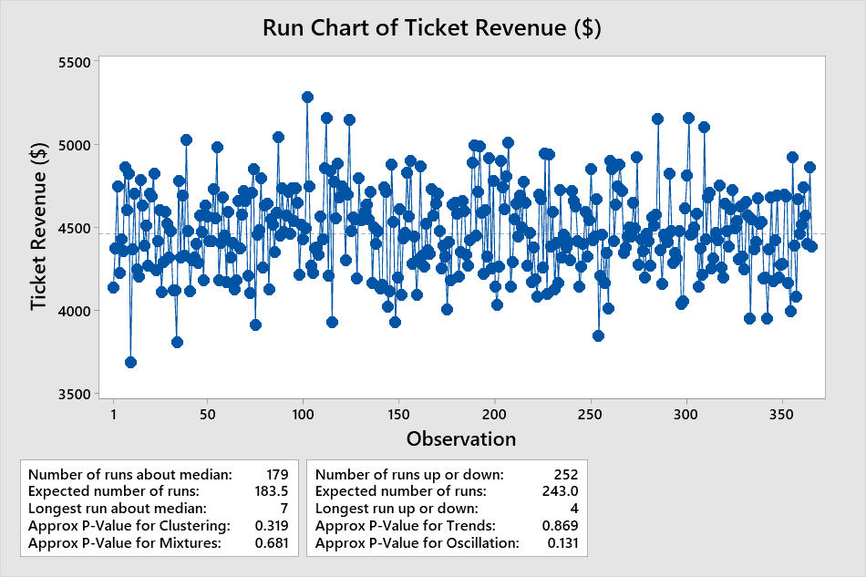
The revenue is roughly stable, with the majority of the points being between $4000 and $5000, while the mean is $4500.

Slide 13
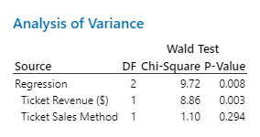
Live Performance vs Films
There is a statistical difference between showing films and showing live performances. Live performance brings in slightly more revenue, but it is not to chance.
As for the ticket sales method, the p-value indicates they are not statistically different, the method of sale does not matter.

Slide 14
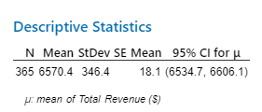
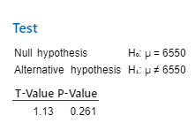
Goal to Increase revenue to $6550 from 2016 to 2017
If average daily total revenue was $6,550 in 2016, did the GM achieve her goal in 2017?
No, The GM did not achieve their goal.
There is a P-Value of 0.261 which means we fail to reject the null hypothesis.
This means that there was not a significant increase in average daily total revenue.

Slide 15
Improvement Plan and Conclusion
We know live performances bring in slightly more revenue, and June is the most underperforming month. We can use this information to capitalize on preference of live performances to improve overall revenue as well as investigate what other factors are affecting June lower revenue.

